Slide 1
Chapter 7
WEB Security

Slide 2
Outline
Web Security Considerations
Secure Socket Layer (SSL) and Transport Layer Security (TLS)
Secure Electronic Transaction (SET)
Recommended Reading and WEB Sites

Slide 3
Web Security Considerations
The WEB is very visible.
Complex software hide many security flaws.
Web servers are easy to configure and manage.
Users are not aware of the risks.

Slide 4
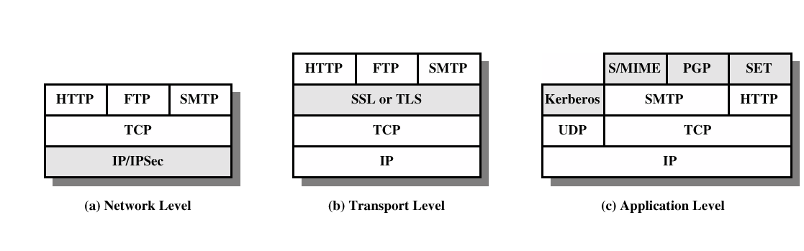
Security facilities in the TCP/IP protocol stack

Slide 5
SSL and TLS
SSL was originated by Netscape
TLS working group was formed within IETF
First version of TLS can be viewed as an SSLv3.1

Slide 6
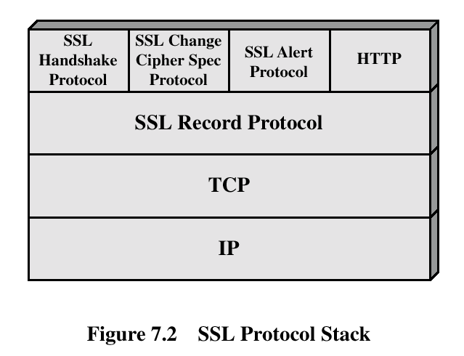
SSL Architecture

Slide 7
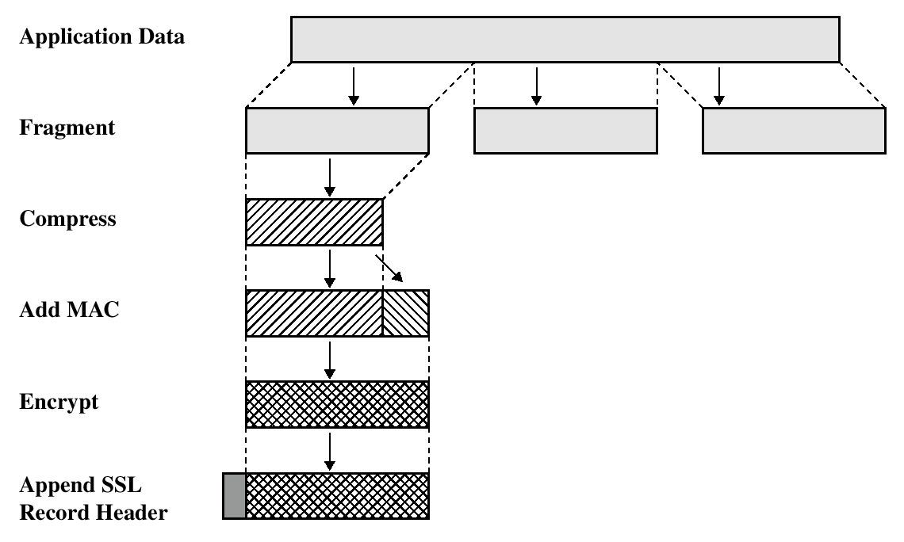
SSL Record Protocol Operation

Slide 8
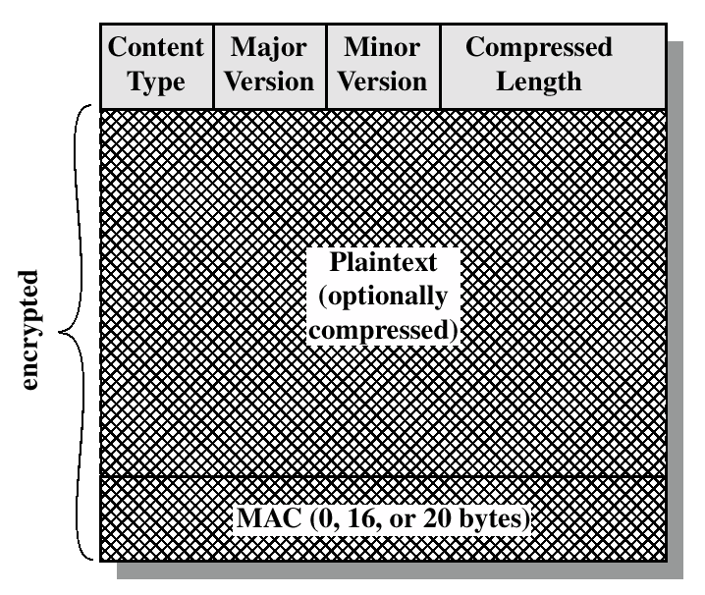
SSL Record Format

Slide 9
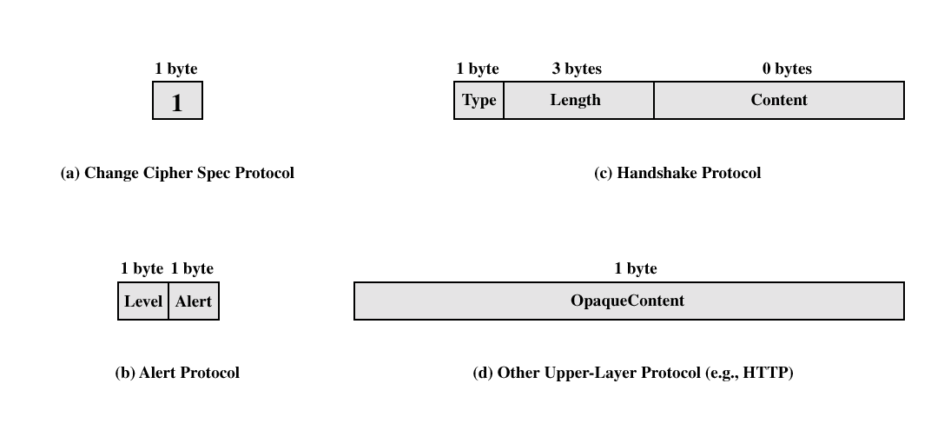
SSL Record Protocol Payload

Slide 10
Handshake Protocol
The most complex part of SSL.
Allows the server and client to authenticate each other.
Negotiate encryption, MAC algorithm and cryptographic keys.
Used before any application data are transmitted.

Slide 11
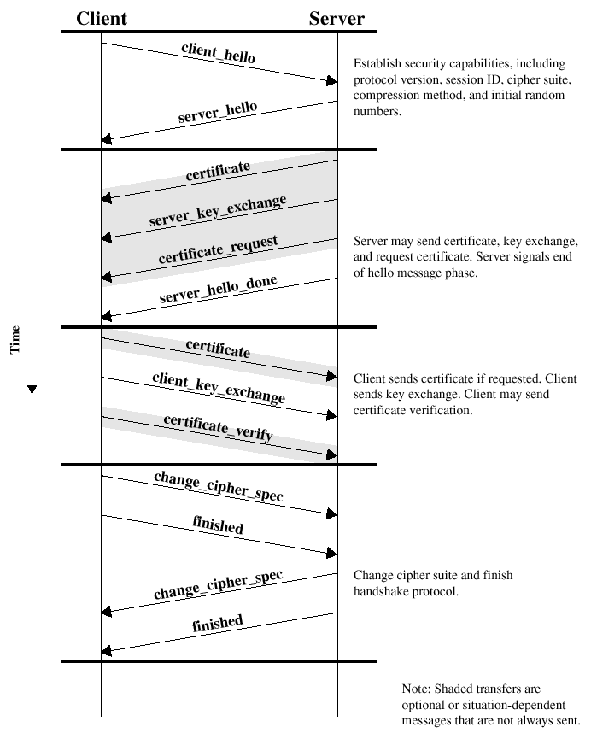
Handshake Protocol Action

Slide 12
Transport Layer Security
The same record format as the SSL record format.
Defined in RFC 2246.
Similar to SSLv3.
Differences in the:
  version number
  message authentication code
  pseudorandom function
  alert codes
  cipher suites
  client certificate types
  certificate_verify and finished message
  cryptographic computations
  padding

Slide 13
Secure Electronic Transactions
An open encryption and security specification.
Protect credit card transaction on the Internet.
Companies involved:
  MasterCard, Visa, IBM, Microsoft, Netscape, RSA, Terisa and Verisign
Not a payment system.
Set of security protocols and formats.

Slide 14
SET Services
Provides a secure communication channel in a transaction.
Provides tust by the use of X.509v3 digital certificates.
Ensures privacy.

Slide 15
SET Overview
Key Features of SET:
  Confidentiality of information
  Integrity of data
  Cardholder account authentication
  Merchant authentication

Slide 16
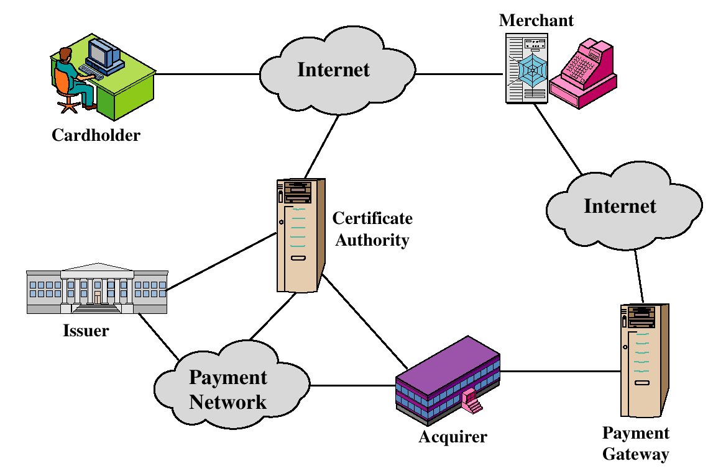
SET Participants

Slide 17
Sequence of events for transactions
The customer opens an account.
The customer receives a certificate.
Merchants have their own certificates.
The customer places an order.
The merchant is verified.
The order and payment are sent.
The merchant request payment authorization.
The merchant confirm the order.
The merchant provides the goods or service.
The merchant requests payments.

Slide 18

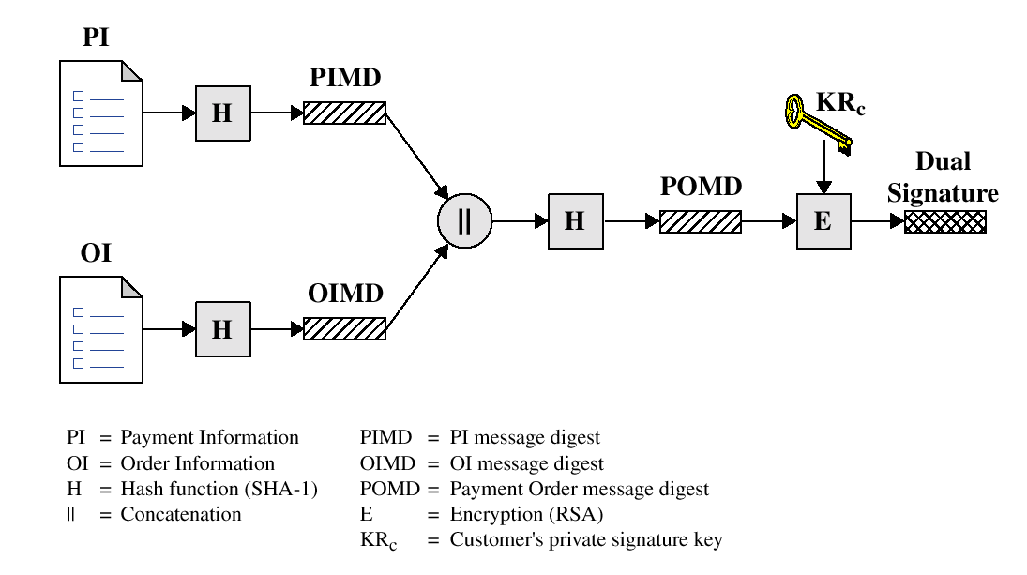
Dual Signature

Slide 19
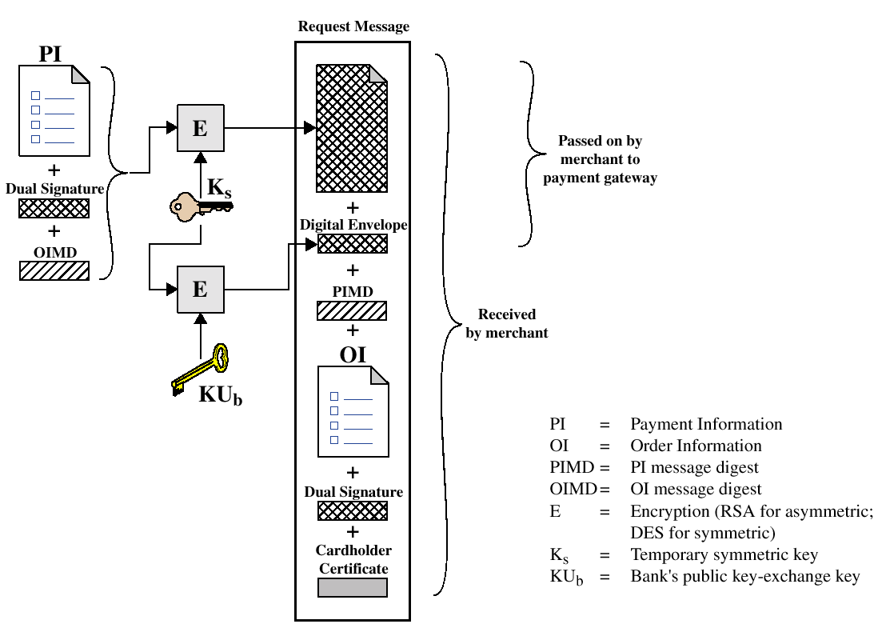
Payment processing
Cardholder sends Purchase Request

Slide 20
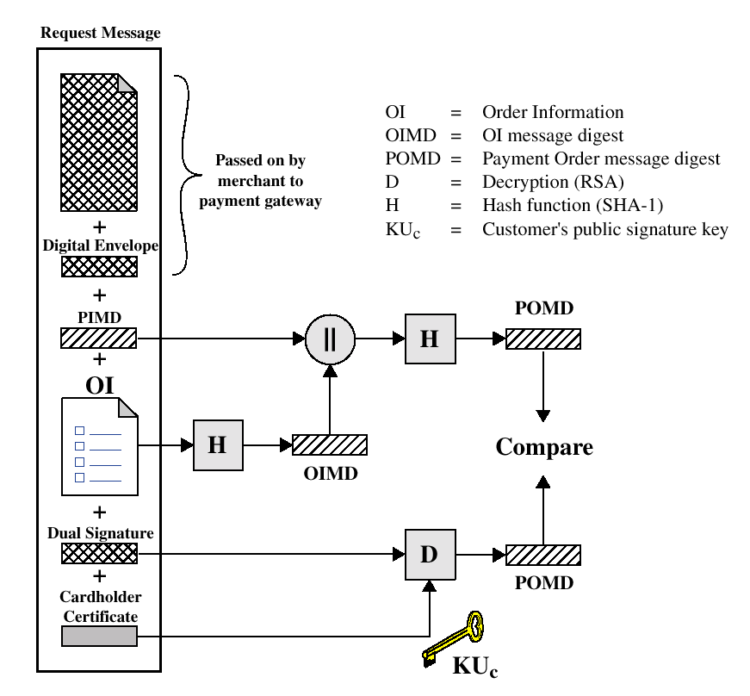
Payment processing
Merchant Verifies Customer Purchase Request

Slide 21
Payment processing
Payment Authorization:
  Authorization Request
  Authorization Response
Payment Capture:
  Capture Request
  Capture Response

Slide 22
Recommended Reading and WEB sites
Drew, G. Using SET for Secure Electronic Commerce. Prentice Hall, 1999
Garfinkel, S., and Spafford, G. Web Security & Commerce. O’Reilly and Associates, 1997
MasterCard SET site
Visa Electronic Commerce Site
SETCo (documents and glossary of terms)

